Slide 1
Big Mountain Resort
data analysis and modelling project for value chain optimization.

Slide 2
Problem Statement
What are the options to absorb the operating cost increase from the new chair lift installation ($1,540,000) during the upcoming season, maintaining a profit margin at 9.2% or higher?
What is the expected annual revenue for present fiscal year if changes proposed are implemented?
1
Context
4
Constraints within solution space
Big Mountain Resort (BMR) has recently installed an additional chair lift to help increase the distribution of visitors across the mountain. This additional chair increases their operating costs by $1,540,000 this season.
BMR has 350,000 customers per season on average.
Product mix includes 3,000 acres of riding terrain with 12% beginner, 38% intermediate, 44% advanced and 6% expert terrain rating distribution. Offer also includes 105 named trails and vast bowl and tree skiing, The longest run is 3.3 miles in length.
BMR’s facilities include 11 lifts, 2 T-bars and 1 magic carpet for novice skiers.
Proposed changes might jeopardize profitability of the company. Must maintain profit margin at 9.2% or higher.
Some solutions could be out of scope, since they are climatic or geographic related characteristics
5
Stakeholders to provide key insight
Decision maker:
Jimmy Blackburn - Director of Operations
Input and resources:
Alesha Eisen - Database Manager
2
Criteria for success
Come up with a set of measures to either cut down expenses or increase revenues in present season to offset the increase in operating costs due to the new chair lift without damaging profitability.
Present annual revenue forecast for present season.
6
Key data sources
3
Scope of solution space
Dataset file in .csv format from database manager
Proposed measures should consider only BMR’s facilities and operations.

Slide 3
Recommendations
Raise permanently weekend and weekday ticket prices by $2.87, which could account for $3,864,000 additional revenue, assuming 350K customers per season and 4-days stay on average.
Consider increasing permanently the adult ticket by an additional 8% to match competitors’ offer or exploit this price gap to attract more customers.
Forward-looking strategic growth plan should consider invest in fast quad and surface (individual) lifts rather than other types of lifts.
Investing in increasing skiable terrain and number of runs can result in higher profit margin.
Consider adding off-season offer to increase the number of days open and thus raise the price for the whole season and revenues.

Slide 4
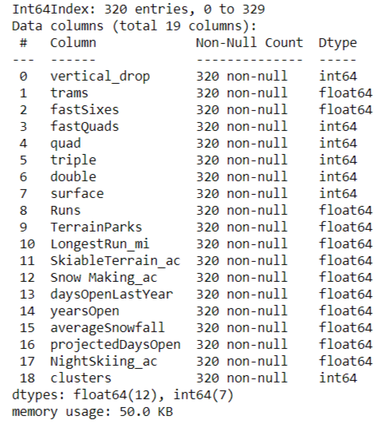
Modeling results and analysis (I)
Analysed variables / Input variables for final model:

Slide 5
Modeling results and analysis (II)
Model prediction performance and accuracy:
Predicted mean adult weekend day pass for all resorts:
56.90
Model predicted BMR Adult Weekend day pass price:
87.06

Slide 6
Modeling results and analysis (III)
Number of fast quads chairs and surface lifts account for 30%-50% more value to customers that simple quad chairs and twice as much as fast sixes and triple chairs.
Besides lift types, available skiable terrain and number of runs are critical features to attract customers.
Vertical drop is the most important feature value-wise for customers, however it is an unchangeable variable.

Slide 7
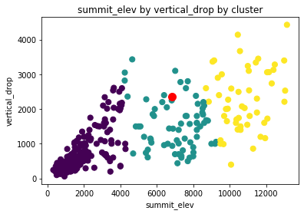
Modeling results and analysis (IV)
Mountain resorts can be grouped by their summit elevation, BMR lays in the middle segment between 4,000 and 9,000 ft.

Slide 8
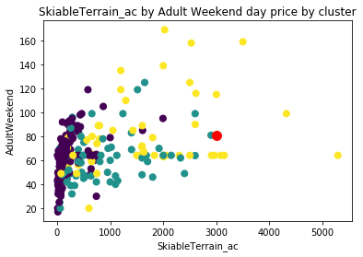
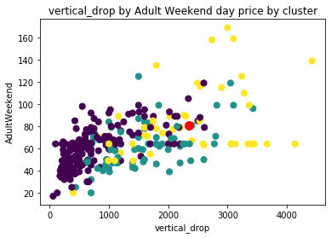
Modeling results and analysis (V)
Weekend day ticket seems to be underpriced by 8.4%. There is room to capture more value by raising weekend day pass price to at least $87.
BMR’s pricing structure is relatively low that their competitors’ when analyzed by vertical drop and skiable terrain
Installation of an additional fast quad chair lift will add $2.87 value per day to customers.

Slide 9
Summary and conclusion
Problem Statement:
A. What are the options to absorb the operating cost increase from the new chair lift installation ($1,540,000) during the upcoming season, maintaining a profit margin at 9.2% or higher?
Raise permanently weekend and weekday ticket prices by $2.87
B. What is the expected annual revenue for present fiscal year if changes proposed are implemented?
Total annual revenue forecast for present season is $117.26M

